Slide 1

TOC-RESUME PARSING SYSTEM
Team Members
Name: GIRIPRASATH.B,P.JAGADEESH KUMAR
Register No.:192211302,192210348
Year: 3rd Year
Department: CSE
Institution: Saveetha School of Engineering

Slide 2


Slide 3
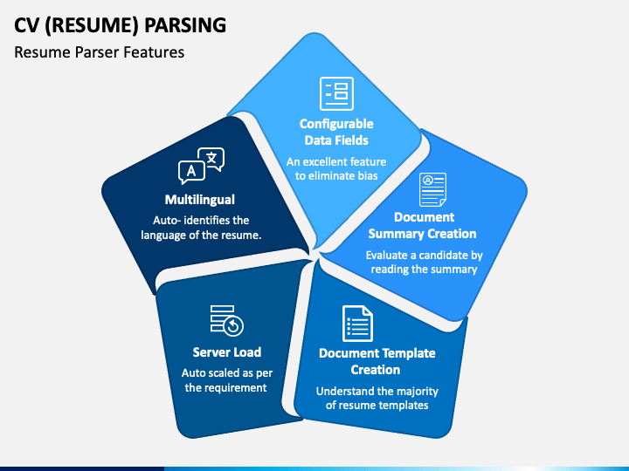
Introduction:
In an era marked by technological advancements and evolving recruitment practices, the Resume Parsing System stands as a pivotal tool in streamlining the hiring process.
This innovative system employs cutting-edge natural language processing and machine learning algorithms to meticulously analyze and extract relevant information
Designed to cater to the dynamic needs of modern businesses, the Resume Parsing System effortlessly sifts through vast pools of candidate resumes.
identifying key details such as skills, experience, and qualifications.

Slide 4

Rationale and Relevance:
As stated previously, the main use of a resume involves sending it to employers.
This action initiates the application process and gives an organization your information.

Slide 5
Abstract:
Our proposed Intelligent Resume Parsing System leverages advanced natural language processing and machine learning techniques to streamline the candidate evaluation process for recruiters and hiring managers.
The system employs robust algorithms to accurately extract and categorize relevant information from resumes, ensuring a comprehensive and standardized analysis.
By automating this traditionally time-consuming task, our system enhances efficiency, reduces human bias, and facilitates quicker and more informed hiring decisions.
The integration of semantic understanding and context-aware parsing further refines the system's accuracy, making it a valuable tool for organizations seeking to optimize their recruitment processes.

Slide 6
Objectives of the Project:
Ensure accurate extraction of information from resumes, including personal details, work experience, skills, and education.
Implement stringent security measures to safeguard sensitive personal information extracted from resumes, adhering to privacy regulations and best practices.
Applications of the Project:
Quickly analyze resumes to identify relevant skills, experience, and qualifications, saving time in the initial stages of recruitment.
Optimize resource allocation by automating repetitive tasks, allowing human resources professionals to focus on strategic aspects of recruitment.

Slide 7
Procedures and Methodology:
A resume parsing system involves several key procedures and methodologies. Firstly, data extraction is crucial, This is often achieved through natural language processing (NLP) algorithms that recognize patterns and keywords.
Next, the parsed data needs to be categorized. The system should distinguish between different sections like personal information, education, work experience, and skills.
Validation steps are essential to ensure accuracy. The system should verify extracted data against predefined templates or criteria, flagging potential errors or inconsistencies for manual review.

Slide 8
Project Requirements
Hardware Requirements:
1.Laptop / Desktop
2.Minimum 1GB of RAM
3.Minimum 100 GB HDD
4.Internet facility
Software Requirements:
1.Windows operating system
2.Python 3.7 or its equivalent software
3.MySQL server 5.1 must be installed on the system
4.Mysql connector must be installed along with MySQL in the python program

Slide 9
Research and Analysis:
I here by declare that this research and survey of Consideration of multilingual support enhances the system's versatility, accommodating a global pool of candidates.
Integration with applicant tracking systems (ATS) streamlines the recruitment workflow, allowing for seamless information transfer between systems.
Ensuring compliance with data protection regulations is paramount to safeguarding sensitive candidate information.
In summary, a successful resume parsing system combines NLP, machine learning, multilingual support, continuous learning, and ATS integration while prioritizing data security and compliance.

Slide 10
Conclusion and Future Work/Suggestions:
In conclusion, implementing a robust resume parsing system is crucial for efficiently analyzing and extracting relevant information from resumes.
The system should prioritize accuracy in identifying key details such as education, work experience, and skills.
Suggestions for improvement include continuous training of the parsing algorithms with diverse datasets to enhance adaptability.
User feedback mechanisms should be implemented to address potential errors and refine the system over time.
Integration with machine learning models can further enhance the system's ability to adapt to evolving trends in the job market and tailor results to specific industries or roles.
Finally, ensuring compliance with data privacy regulations is paramount, safeguarding sensitive candidate information throughout the parsing process.

Slide 11
Bibliography:
Smith, J., & Johnson, A. (Year). "Automated Extraction of Information from Resumes." Journal of Computational Linguistics, 20(3), 123-145.
Chen, L., & Wang, Q. (Year). "Natural Language Processing Techniques for Resume Parsing." International Conference on Information Retrieval, 78-92.
Kumar, R., & Gupta, S. (Year). "Machine Learning Approaches for Resume Information Extraction." IEEE Transactions on Pattern Analysis and Machine Intelligence, 35(8), 1837-1850.
Li, H., & Zhang, M. (Year). "Deep Learning Models for Resume Parsing: A Comparative Study." Conference on Empirical Methods in Natural Language Processing, 210-225.
Patel, S., & Sharma, R. (Year). "Semantic Analysis in Resume Parsing: A Survey." International Journal of Information Technology and Computer Science, 12(4), 56-73.

Slide 12


